Slide 1

The Legend of Zelda Breath of the Wild
An Analytical Guide to Help You Overcome Ganon’s Calamity
Presented by
Annie DeRossi
Drew Henning
Ronald Canepa
Zaira Coronado
Notes:
Annie: play music
Drew: read headline
Ronnie: Yo, team Mongoose. Let’s kick it!
Annie: raps
Drew: Music in the style of Vanilla Ice
Lyrics provided by Annie DeRossi
Thank you, Annie for that sick introduction

Slide 2
It’s Dangerous to go Alone! Take This…
Questions
Why?
Can a player use data to help them through the game?
How do I know which weapons to use?
What armor will help me in certain conditions? What should I wear into battle?
How do I defeat enemies?
What should I cook to help replenish my strength?
Why do we ask these questions?
Some weapons, armor and food/recipes are better than others.
Some monsters are stronger than others. We want to know what items we can use to defeat strong enemies.
What armor to wear to make me stronger.
What recipes to cook to help replenish my strength, etc.
All this information will help players get through the game in a data driven way

Slide 3
Data and Sources
Sources
Data Clean Up
API via GitHub
CSV file from Airtable
Legend of Zelda Breath of the Wild
Data clean up was not easy. The API used was very limiting as it provided little quantified data. We wanted more to work with and decided to further research.
We also used a CSV file from Airtable which provided thorough information. Such as specified weapons and armor data, along with recipes for cooked foods.
The biggest challenge was writing the correct code to help us extract exactly what we needed while leaving behind anything that wasn’t useful.
Game Elements
Weapons
Armor
Monsters
Food
Notes:
We had Drew play the game as we cleaned the data to confirm what we are using is accurate

Slide 4
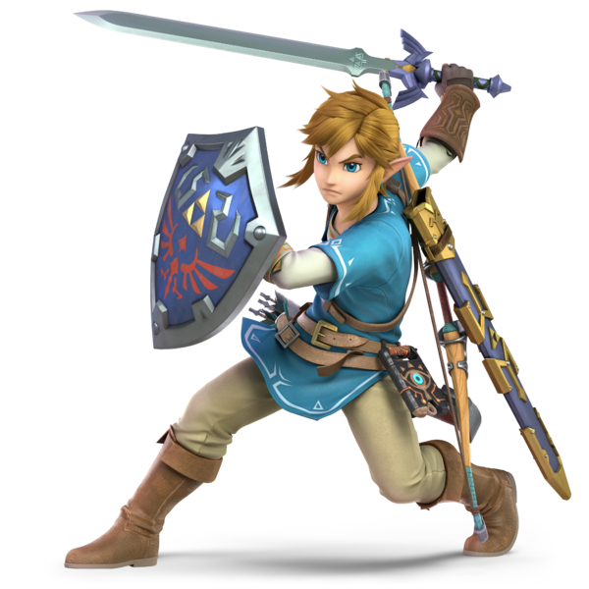
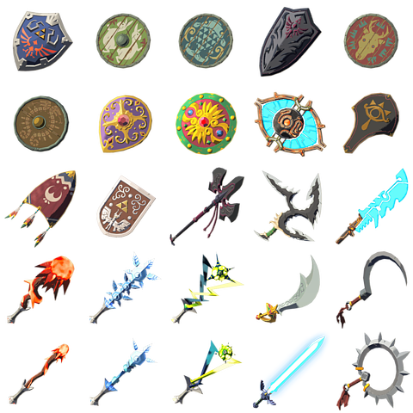
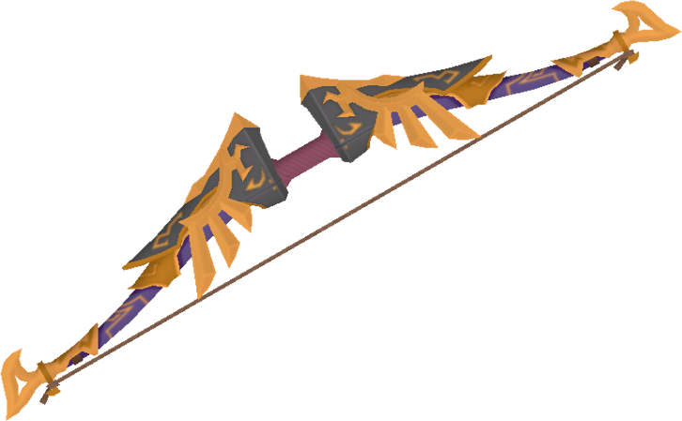
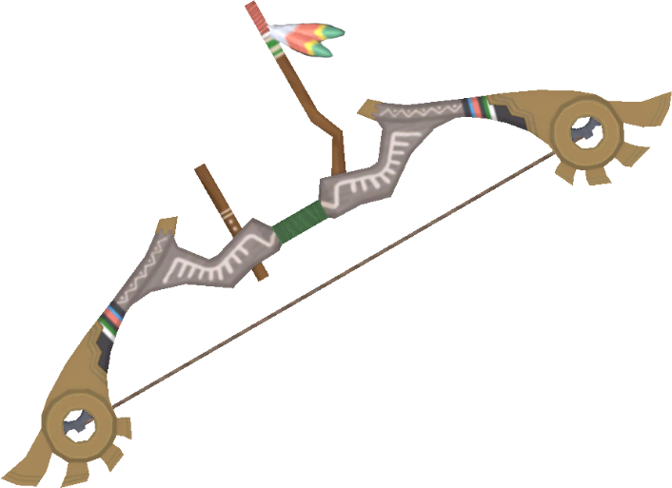
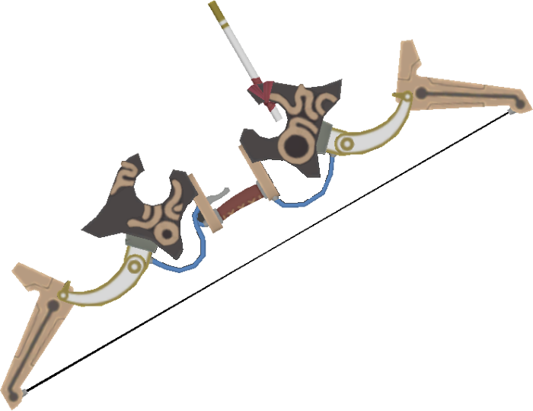
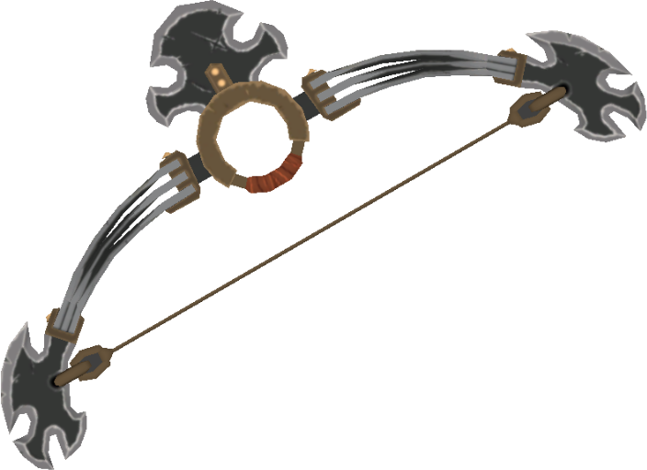
Weapons
Swords
Shields
Bows
Notes:
The journey through Hyrule is long and treacherous. It is important to equip oneself with weapons that will not only inflict the greatest damage, but that will also last through this journey. In the next slides, we will be looking at a few equipment recommendations that are both strong and durable.

Slide 5
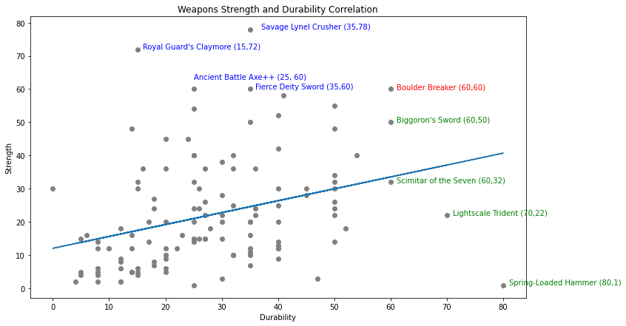
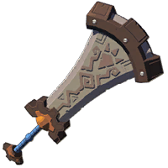
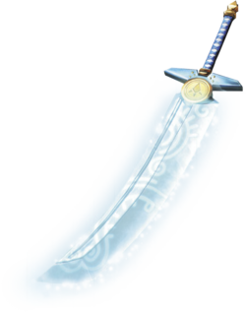
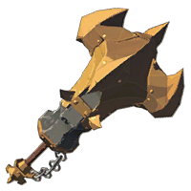
Weapons Strength and Durability
There is not a strong correlation in between strength and durability amongst weapons
Top Weapon Choices : Boulder Breaker, Biggoron’s Sword, and Savage Lynel Crusher.
Boulder Breaker
Biggoron’s Sword
Savage Lynel Crusher
Notes:
When it comes to weapons, you usually have to choose between strength and durability.
A weapon that is high in durability will last you through a hard battle without breaking. It will just take you longer to defeat that enemy since the strength is not as high
Alternatively, a weapon with high strength might be able to kill an enemy faster but will break on you more often.
We can see from the scatterplot that the strongest weapons such as the Savage Lynel Crusher is not ass durable as the Spring- Loaded Hammer.
Although the Spring Loaded Hammer on the bottom right is the most durable, it has a strength level of 1 , being the weakest weapon around.
For this reason, we recommend carrying the Boulder Breaker overall, since it is equally strong and durable, Biggoron’s Sword for weaker enemies due to its durability , and the Savage Lynel Crusher for its strength for the more difficult monsters.

Slide 6
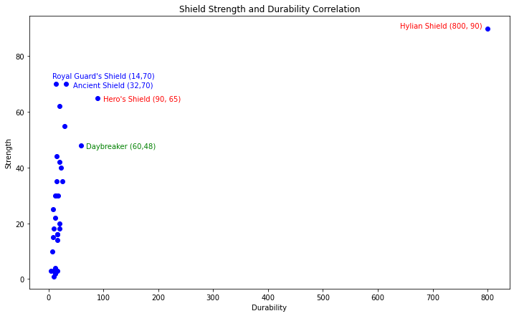
Shield Strength and Durability
There is a strong positive correlation amongst most shields aside from the Hylian Shield being the only outlier
Top Shield Choices: Hylian Shield, Hero’s Shield, Ancient Shield , and Daybreaker
Hylian Shield
Hero’s Shield
Ancient Shield
Daybreaker
Notes:
Unlike the weapons, shields tend to have a stronger correlation between strength and durability, with the clear outlier being the Hylian Shield.
The Hylian Shield is the most durable out of all shields, but it is usually acquired towards the end of the game.
So what shield should you use in the meanwhile?
The Hero’s Shield, and the Ancient Shield are our recommendations as they are the strongest in protecting you from monster attacks lessening the amount of damage you take on
We also recommend the Daybreaker as well as it is one of the most durable.
These shields will be saving you lives , enabling you to make more progress in the game.

Slide 7
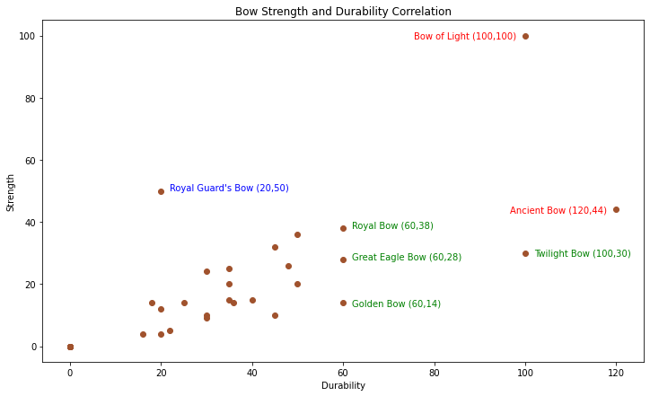
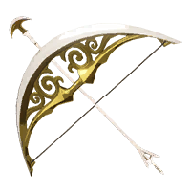

Bows Strength and Durability
Bows are a reliable weapon for Link due to their toughness and durability.
Top Bow Choices: Bow of Light, Ancient Bow, Twilight Bow
Bow of Light
Ancient Bow
Twilight Bow
Notes:
Compared to weapons and shields, bows are known to be tougher and therefore be more durable.
For bow recommendations:
The Bow Light shown at the top right is by far the best attacking bow as it is equally durable and strong but it is also acquired toward the end of the game.
The Ancient Bow is the most durable in the game and will last the longest without having to be rebuilt constantly,
And the Twilight Bow would be our 3rd choice since it has the same durability as the Bow of Light but this can be used towards weaker enemies.

Slide 8

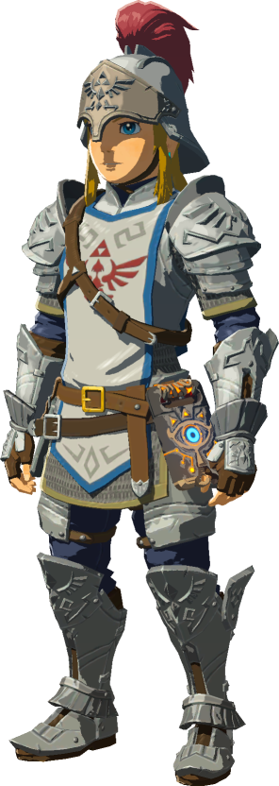
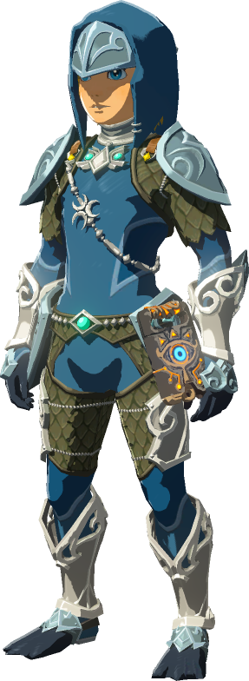
Armor
Stealth Armor Set
Soldier Armor Set
Zora Armor Set
Notes:
Armor is just as important as your weapons, so choose wisely which one you’d like to wear as it can change your gameplay experience for the better or the worse

Slide 9
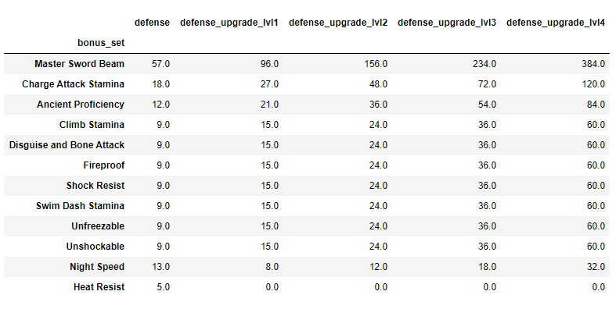


Is Defense the Only Stat You Should Consider?
Warm Doublet
Snowquill
Although defense is something to consider when choosing armor, wearing a complete armor set can greatly benefit you on your adventure in Hyrule.
If you’re off adventuring in Mount Hylia, a Warm Doublet will suffice. However, to survive the harsh, unforgiving freezing temperatures of Hebra Mountains, a Snowquill set will give you an unfreezable bonus.
Notes:
Talk about the DataFrame and what the graph shows
Armor sets consist of head, body and leg armor.
After Snowquil bonus set - point at unfreezable bonus set and provide the defense gained from base to level 4
Previous adventures - such the cap, tunic, and trousers of Time from Ocarina of Time or the cap, tunic, and trousers of the Wind from Wind Waker

Slide 10
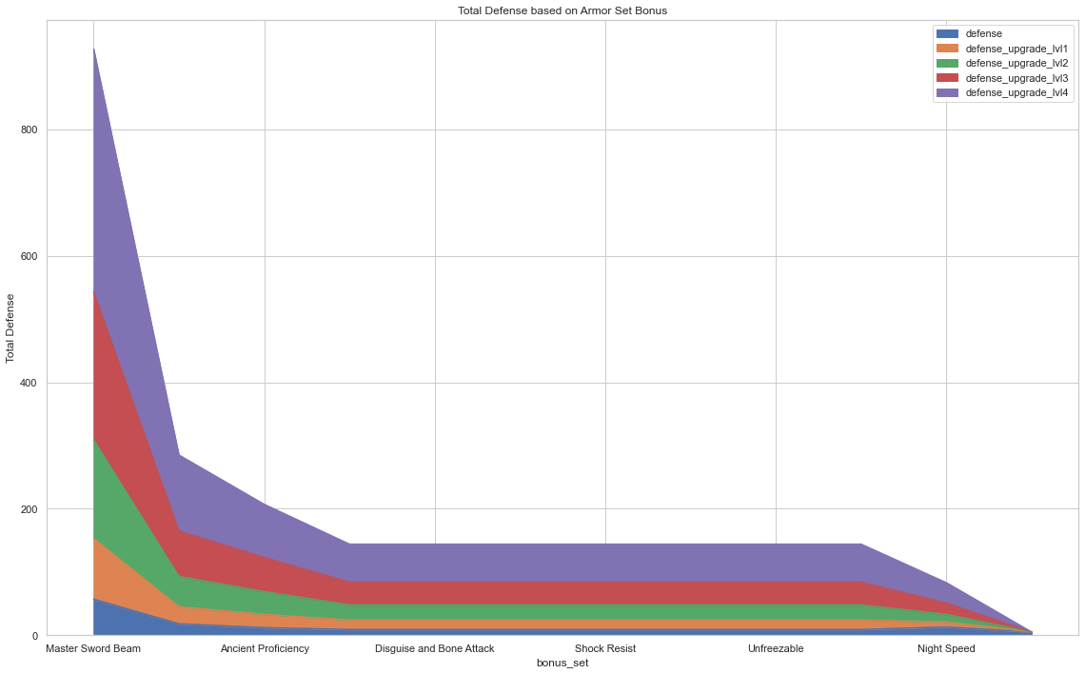
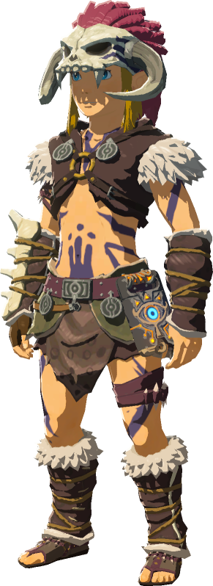
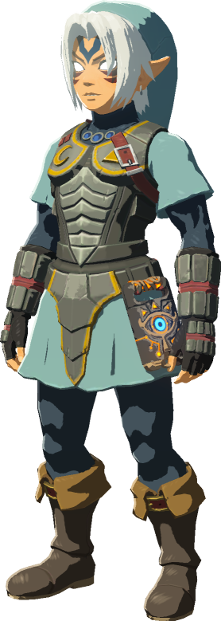
Total Defense based on Armor Set Bonus
Barbarian Set
Fierce Deity Set
The Master Sword Beam bonus set reflects a much higher defense sum of 384 due to the six types of armor sets that you can wear. Five of which have a sum of 60 (+20 defense for each piece), and only one with a sum of 84 (+28 defense for each piece).
The Charge Attack Stamina bonus set is acquired by wearing the Barbarian armor or the Fierce Deity armor that grants you a total of +6 defense at a base level and a + 60 defense at level 4. Obtaining the full bonus set at a level two upgrade.
Notes:
Talk about the DataFrame and what the graph shows
Armor sets consist of head, body and leg armor.
After Snowquil bonus set - point at unfreezable bonus set and provide the defense gained from base to level 4

Slide 11
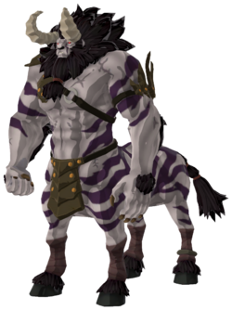
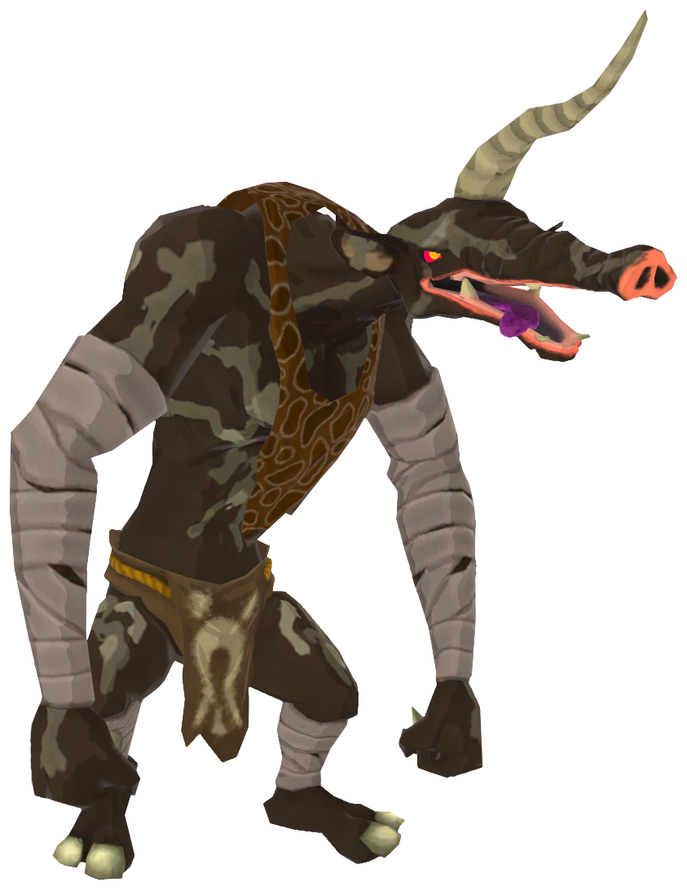
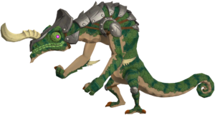
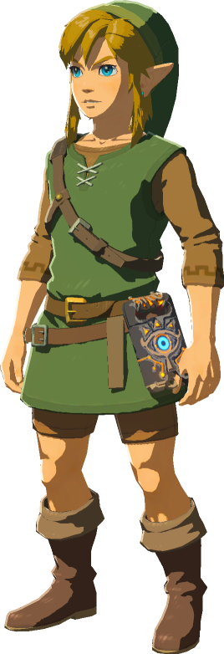

Monsters
Bokoblin
Lizalfos
Moblin
Lynel
Notes:
Monsters are one of the key elements in any video game
When defeating monsters in Zelda Breath of the Wild, they leave behind various items that are called drops
Monster drops can be any combination of monster parts, food, treasure, etc.
What can you do with monster drops? How can they be used? What are valuable drops?
In this section, I will show you the different type of monsters, what they drop and how to find value in their drops

Slide 12
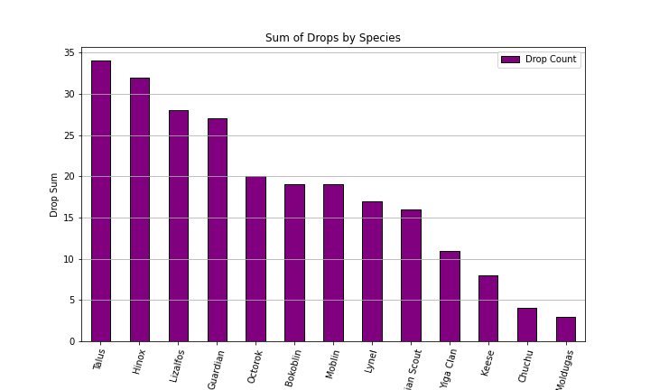
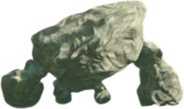
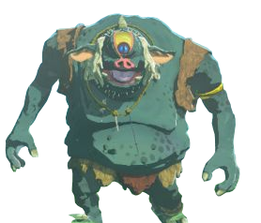
Monster Analysis by Species
Talus
Lizalfos
Hinox
This bar chart shows us the sum of drops by each species of monster
These species of monsters in general will produce more drops, therefore, fighting any of the monsters within that species will yield a higher reward
Notes:
Top 3
Talus (34)
Hinox (32)
Lizalfos (28)
As the sum for each species increase, you will need to defeat less of these monsters if you are looking to add to your inventory
As the sum for each species decrease, you will need to defeat more of these monsters if you are looking to add to your inventory

Slide 13
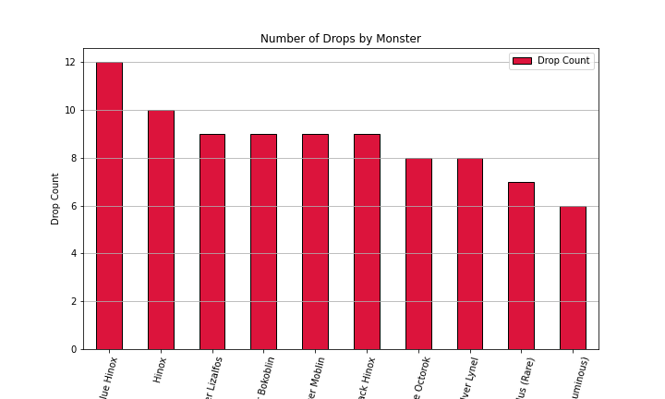
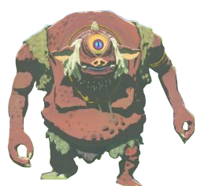
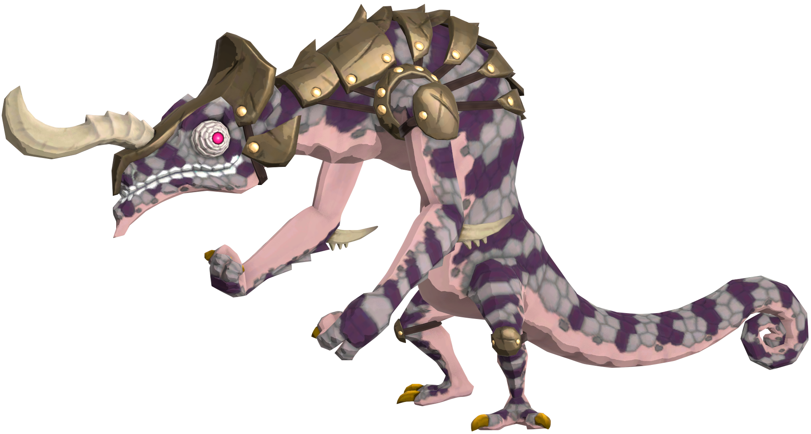
Monster Analysis by Individual Monster
Blue Hinox
Hinox
Silver Lizalfos
This bar chart shows us the number of drops by each individual monster
These monsters will produce more drops after defeat which provides more value to your inventory when collecting items
Notes:
Blue Hinox with (12)
Hinox with 10 (10)
Silver Lizalfos (9)
It is likely that the higher the drops, the more difficult the enemy is. More information is needed to prove this analysis
Additionally, we can use basic statistics to form a stronger analysis.
The average number of drops each monster produces is 3.966. How accurate is this? We use the standard deviation to measure how far away this average deviates from the true value.
The standard deviation of monster drops is 2.557. What does 2.557 tell us?
A strong standard deviation is ±2.
Therefore, we can confidently say that a monster with drop counts greater than 4 (above average) will yield a higher reward/add more value to your inventory.

Slide 14






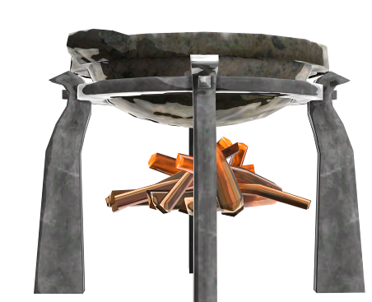

Food, Recipes and Elixirs
Notes:
*Cooking ingredients aids in many ways: Defense, Attack, Stamina, and more. But of these extra add-ons, adding more hearts is the most beneficial.
*Do you need to know all the recipes? No, knowing the Roasted Big Radish will give you the most extra hearts.
*So where can you get the best bang for your buck? The Hearty Radish is where it’s at, adding 17 extra hearts. Although they are fairly sparse in the wild, you can buy them in a few shops.
In addition to fighting Monsters and gaining experience, you can also find ingredients and recipes.
If you’re looking for other effects you will want to amp up your clothing and weapons.
But it does help to know other recipes as well. A chef with a well rounded repertoire is hard to come by.
It pays to keep an eye out while in the wild, you never know what you might find.

Slide 15
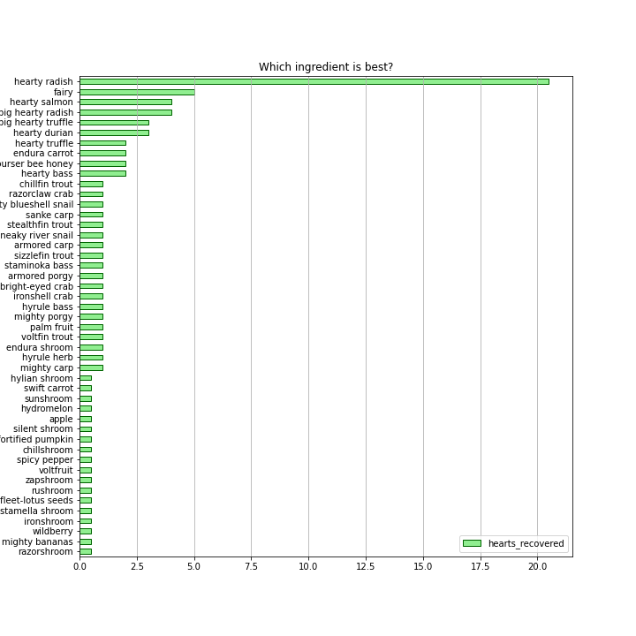
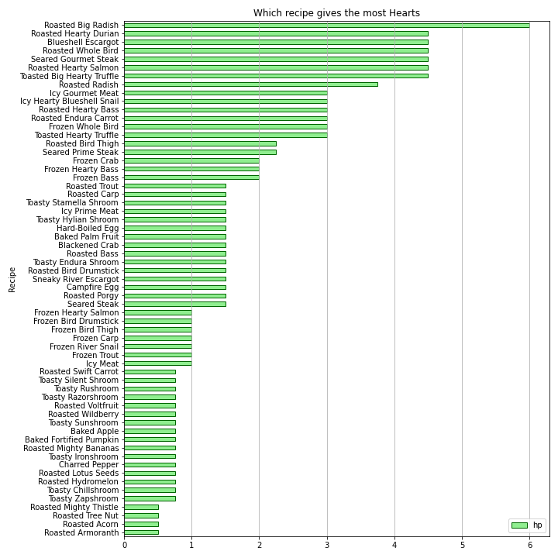
Here’s What’s Cookin’
Notes:
In the chart on the left you can see that the Hearty Radish will bring your heart count total to over 20 hearts. Whereas the chart on the right shows the amount of hearts added to your current count. Given the data provide, it’s clear that there is an obvious choice in each category. Now it’s up to you to get out there and forage for ingredients and knowledge! Be sure to have any recipes or ingredients prepared and on hand before getting yourself into any trouble.

Slide 16
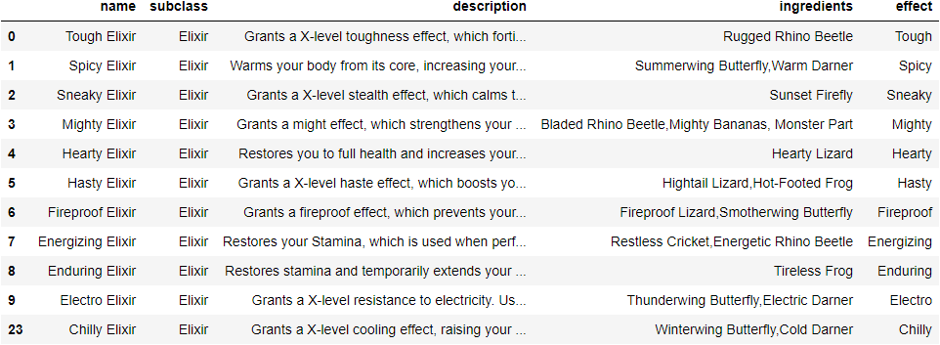
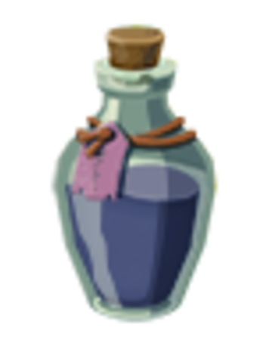
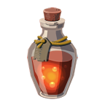
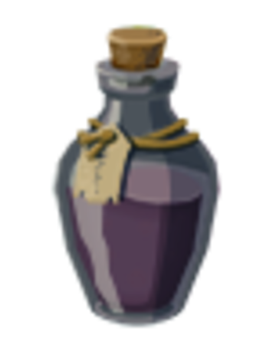
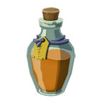
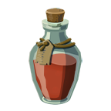
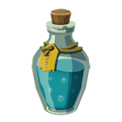
Out of Recipes? Try an Elixir
Tough
Spicy
Sneaky
Mighty
Hearty
Hasty
Notes:
Foraging for ingredients or having everything you need for a specific recipe may not be an option for you. If that’s the case you can opt for an elixir. They are a quick and easy way to get the boost you need without all the hassle! For example, finding the Hearty Lizard is a much easier feat than foraging for a Hearty Radish and the Hearty Elixir will give you the same boost, if you are looking to amp up your heart count.

Slide 17

Final Observations
Weapons
Monsters
Obtain the best weapons you can find. We recommend finding weapons that are similarly durable and strong.
Conserve your weapons for when you battle stronger monsters. Don’t waste them on weak opponents.
Durable weapons will last longer in harder battles
Stronger weapons will cause more damage
When you combine these two, you’ll be in great shape!
The higher the drop count, the more valuable these drop items are when defeating a monster.
Alternatively, the lower the drop count, the less valuable these drop items are when defeating a monsters.
It is likely that the higher the drop count is for each monster, the stronger of an enemy they are. More information is needed to run this analysis.
Armor
Food
Cook, cook, cook! If you are unable to upgrade your armor or need help in a challenging fight, recipes and elixirs will restore your health and can temporarily give you a boost.
Carrying different armor sets can greatly increase your chance of survival in all conditions.
Upgrading your armor sets to achieve a bonus will increase your defense against attacks.

Slide 18
Final Observations (cont.)
Answers
Can a player use data to help them through the game? Yes!
How do I know which weapons to use? We recommend the Boulder Breaker, Biggoron’s Sword and Savage Lynel Crusher for the strongest and most durable.
What armor will help me in certain conditions? What should I wear into battle? Complete your armor sets for an additional bonus which greatly increase your protection in certain conditions and to help increase defense in battles.
How do I defeat enemies? Strong weapons should be used on strong enemies. Weaker weapons should be used on weaker enemies.
What should I cook to help replenish my strength? Hearty radishes if you can find them. If not, the Hearty Elixir will fully recover all your hearts
Notes:
When combining your strongest weapons with upgraded armor and quality recipes, you will be in great condition for whatever comes your way!

Slide 19
Fight On
Notes:
Questions?

